Slide 1
Aircraft Performance Logger
IIB Project – Easter Presentation

Slide 2
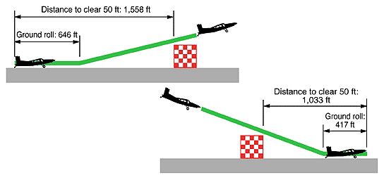
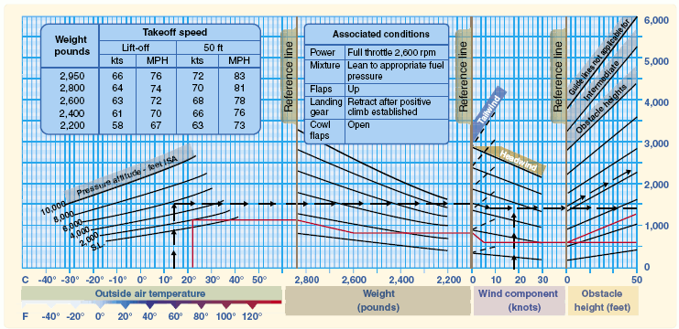
Problem definition
Performance characteristics of airplanes:
Ground roll
Distance to clear 15 m = Take off distance required (TODR)
Accurate data for safety, creation of performance charts
Current methods:
Expensive DGPS, image processing or laser systems
By-eye by test pilots
Want a cheap module separate from aircraft.
Ground roll and TODR definitions
Performance chart example

Slide 3
Project Plan
Michaelmas – Proof of concept
Lent – Design, Build
Charactise GPS and pressure sensor
Explore ways to make GPS readings more accurate
Decide on method of measuring distance and altitude going forward
Choose method of controlling electronics
Choose data processing method
Design PCB
Assembly PCB and module
Program microcontroller
Easter – Test, Write up
Testing
Static
Flight
Write up

Slide 4
‘Cheap’ DGPS
Errors in readings due to multipath, ionosphere, reflection of signals, etc
Corrections usually done on signals themselves
Blue ‘base’ readings, average is true location
Pair each ‘base’ reading to red ‘roaming’ reading
Find orange error vector between base reading and average
Subtract from red roaming to correct it
Longitude
Latitude

Slide 5
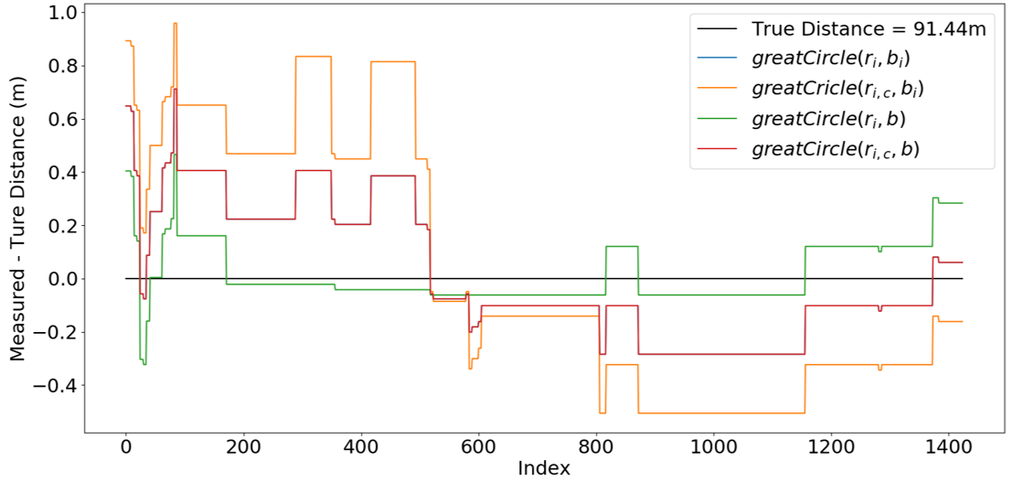
Results: ‘Cheap’ DGPS doesn’t work
‘100m Test’ True distance = 91.44m | Distance Delta (m) | MSE (m²) | σ (m)
Uncorrected | 1.3602 | 0.0632 | 0.2507
Corrected | 1.3602 | 0.2246 | 0.4734

Slide 6
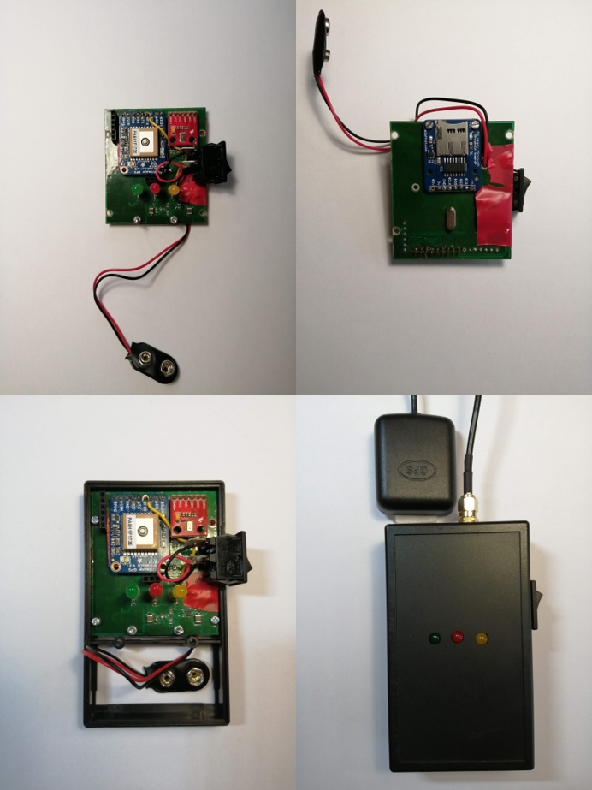
Results: The Module
LED
LED
LED
GPS Module
UART
Microcontroller
Pressure Sensor
I2C
Switch
SPI
SD Card
Final Module
Block diagram of design

Slide 7
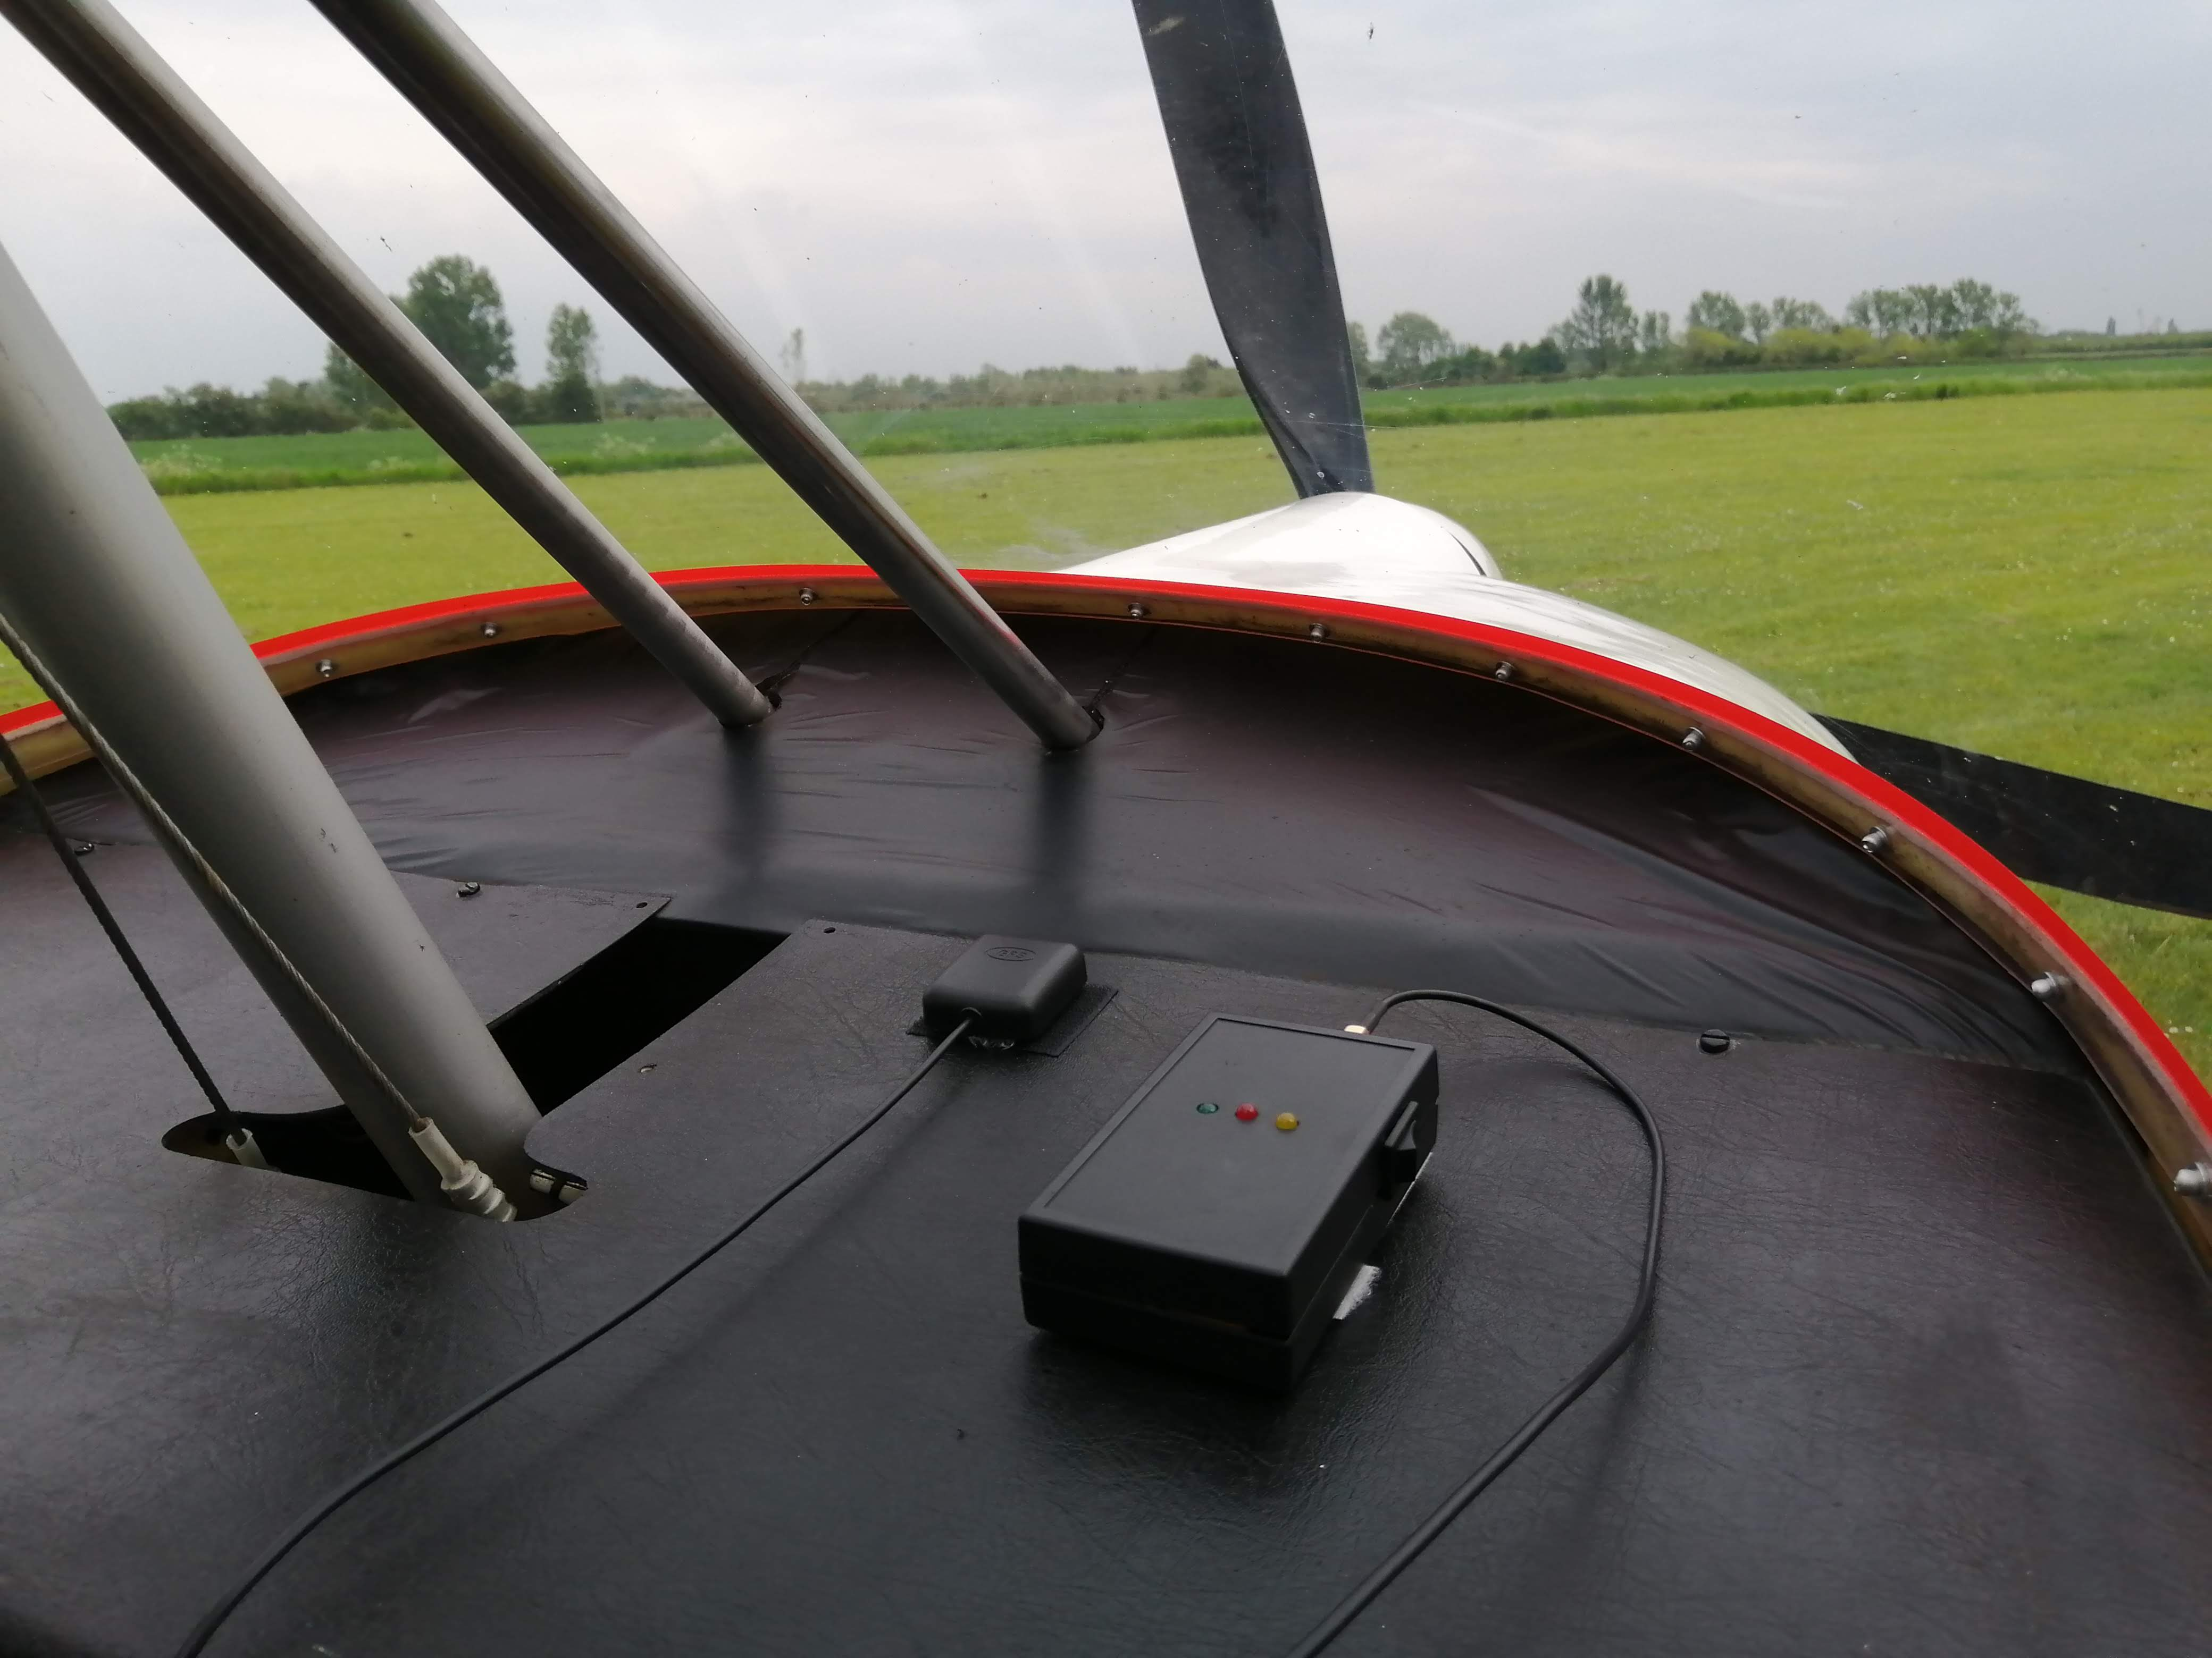
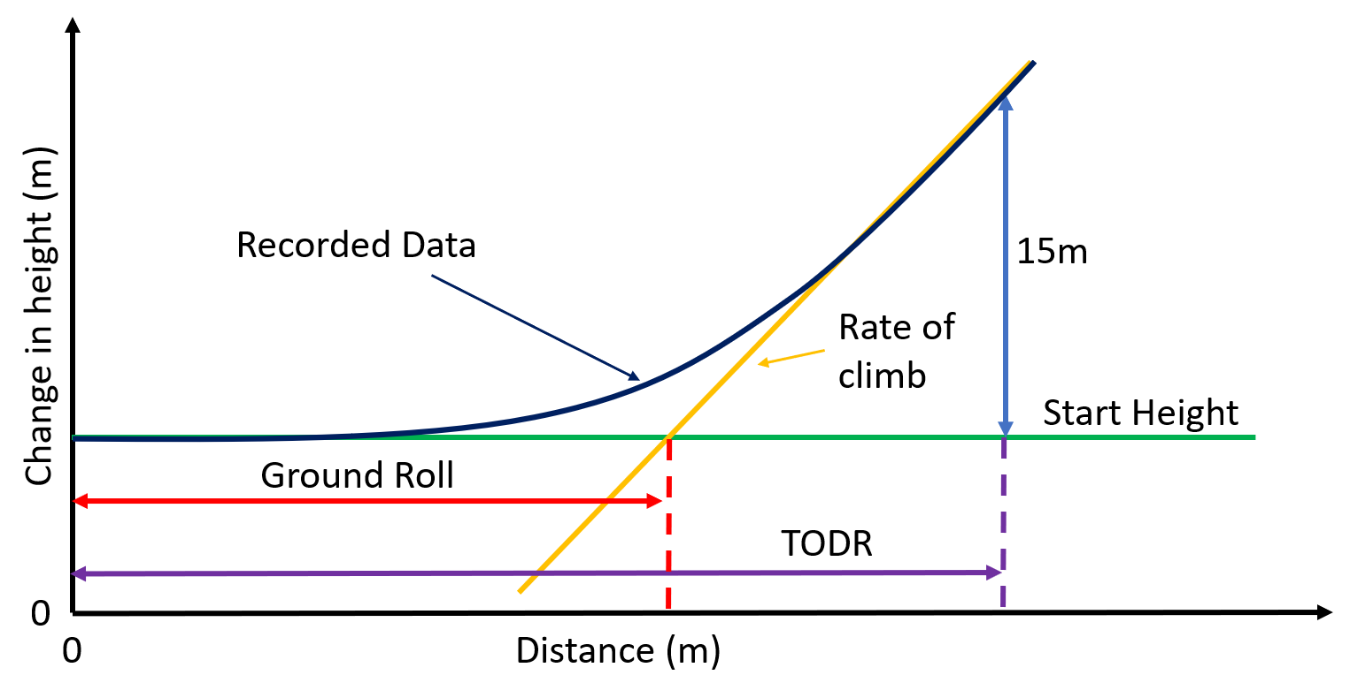
Results: Calculating TODR
The run data of distance vs height is plotted.
Assuming a linear rate of climb, the line of best fit for the climbing phase is calculated.
This line is extended for the entire run (orange line).
The average height for the runway is plotted and extended for the length of the whole run (green line).

Slide 8
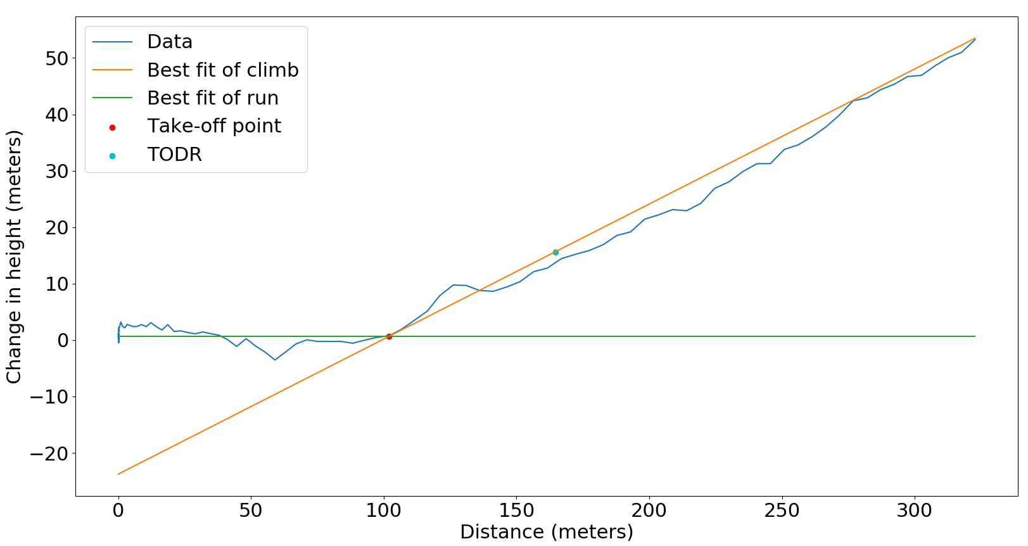
Results: TODR and Ground Roll
3.2m jump
Ground Roll: 101.91m
TODR : 164.58 m
Handbook value : 195 m

Slide 9
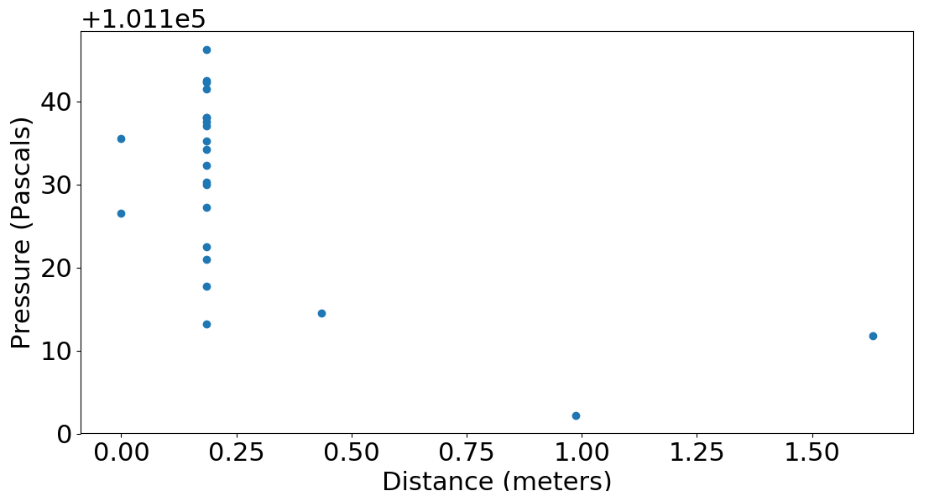
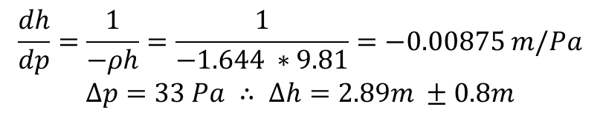
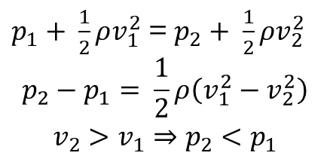
Results: Effect of propeller wash
Propeller speed increased as take-off starts
Increased airspeed through propeller means lower pressure
Causes an apparent jump in height
$p_{1}+ \frac{1}{2}ρv_{1}^{2}$ = $p_{2}+ \frac{1}{2}ρv_{2}^{2}$
$$p_{2}−p_{1}= \frac{1}{2}ρ\left(v_{1}^{2}−v_{2}^{2}\right)$$
$$v_{2}>v_{1}⇒p_{2}<p_{1}$$
$$\frac{dh}{dp}=\frac{1}{−ρh}=\frac{1}{−1.644 ∗9.81}=−0.00875 m/Pa$$
$$∆p=33 Pa ∴ ∆h=2.89m ±0.8m$$

Slide 10
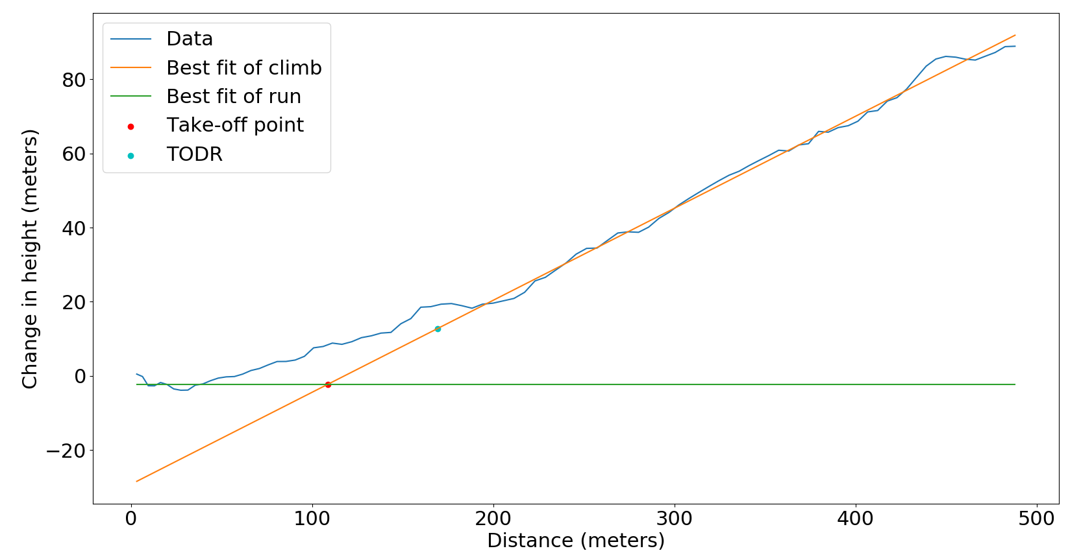
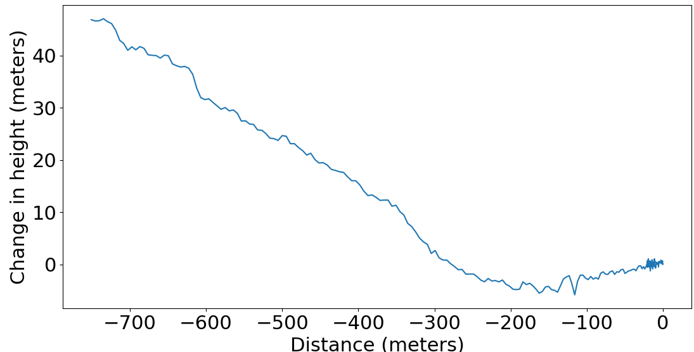
Conclusions
‘Cheap’ DGPS not used as no improvement on accuracy
Method of calculating TODR sometimes overestimates take off point
Pressure sensor accuracy less than desired due to
Oversampling rate
Propeller wash
Dynamic effects
Module, with further development, can measure other parameters, such as landing

Slide 11
Aircraft Performance Logger
IIB Project – Easter Presentation

